Slide 1
Recap Slides for SRV analysis_tools sprint
LSST-DESC sprint week October 2022 (the one with the snow)

Slide 2
Analysis tools overview
Spent first day going over an analysis tools overview: https://docs.google.com/presentation/d/1UzZEq4oEh1rKZY-CTR0lnoXXgKUuk1T3pHzt9NJg_ow/edit?usp=sharing And a notebook tutorial https://github.com/lsst-dm/analysis_tools_examples/blob/main/analysis_tools_demo.ipynb%20
We can run analysis tools on the Rubin Science Platform, on the command line using the pipetask command, through jupyter notebooks by importing analysis tools directly.
On nersc the easiest way to try this out is to use the desc-stack-weekly-latest kernel and import analysis tools…

Slide 3
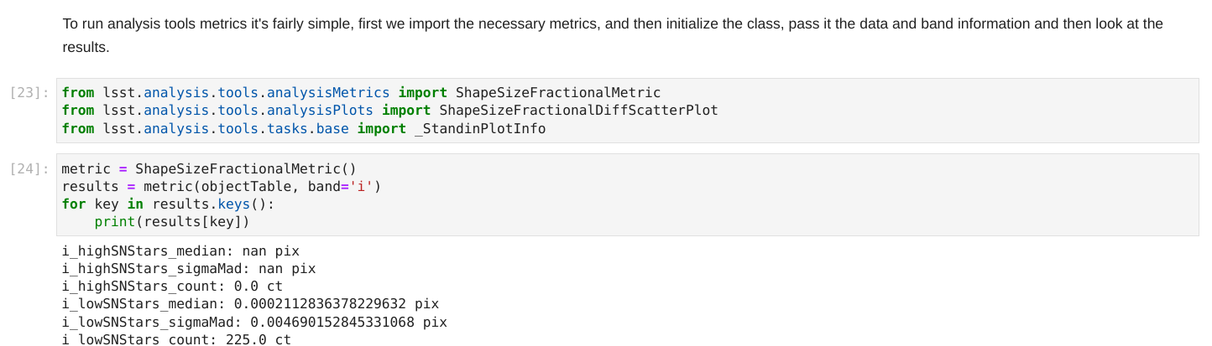
Analysis tools overview - playing around with Jupyter
https://github.com/LSSTDESC/SRV-planning/blob/main/analysis_tools_guides/analysistoolsnotes.ipynb
to get you started at nersc with some example data, then look at Keith’s document for more info.
Notes: use desc-stack-weekly-latest kernel, paths for example data are in the notebook
Can code up your own analysis_tools action this way

Slide 4
Analysis tools overview - using RSP (terminal) on https://data.lsst.cloud/
Make sure to run setup lsst_distrib Get analysis tools through github link: https://github.com/lsst/analysis_tools
Then follow this guide to link to your local version https://pipelines.lsst.io/install/package-development.html?highlight=github#un-set-up-the-development-package
Path is in analysis_tools/python/lsst/analysis/tools, you can alter an Action, e.g. copying an altering an analysisPlots class (remembering to update the list at the top of the file and add the import to the __init__.py). Then create a pipeline yaml file and call it with pipetask
pipetask run -p pipelines/testPlots.yaml -b dp02 -i 2.2i/runs/DP0.2 -o u/${USER}/newPlotTest --register-dataset-types -d "tract=3446 AND skymap='DC2'" (every time you run this after the first add --prune-replaced=purge --replace-run to this) Now look at Sophie’s guide for more info and examples :)

Slide 5
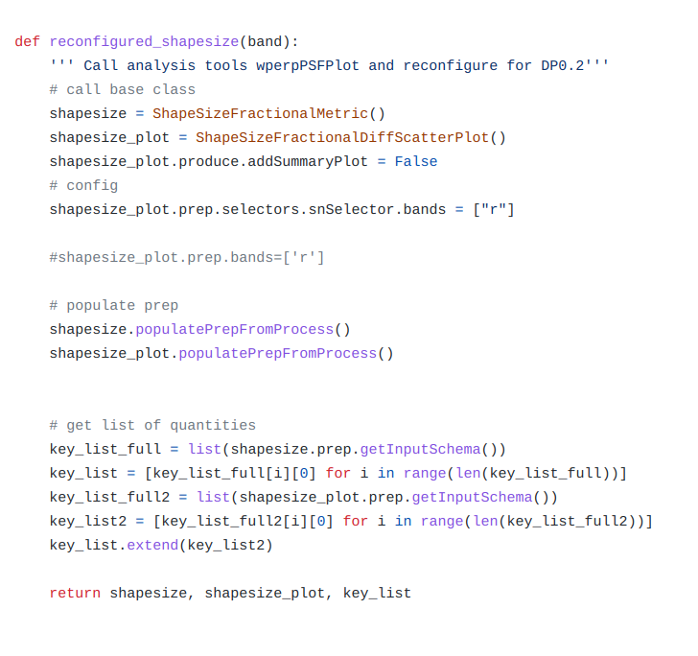
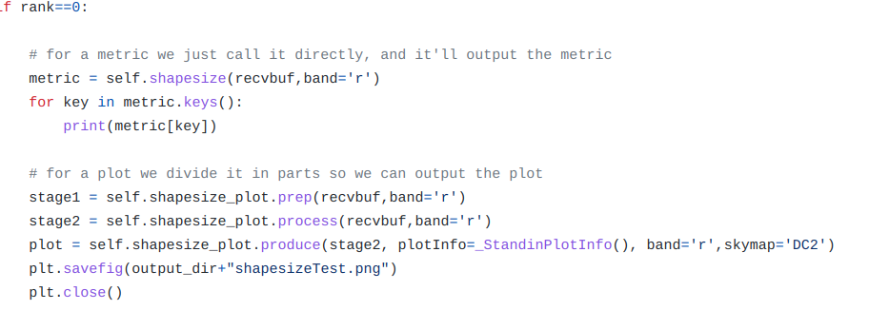
Analysis tools overview - using DESCQA
Implemented analysis tool metrics/plots as descqa tests E.g. https://github.com/patricialarsen/descqa/blob/master/descqa/srv_analysistools_ShapeSizeFractionalMetric.py

Slide 6
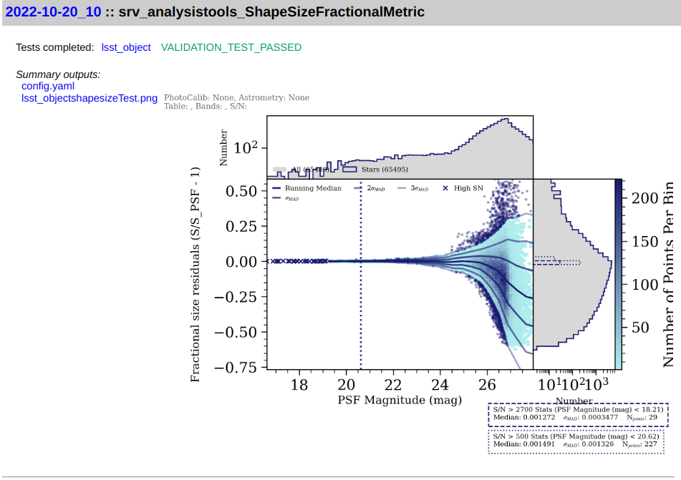
Analysis tools overview - using DESCQA
Implemented analysis tool metrics/plots as descqa tests E.g. https://github.com/patricialarsen/descqa/blob/master/descqa/srv_analysistools_ShapeSizeFractionalMetric.py
We haven’t set it up to properly report metrics to the summary.html table yet, but we do have them printing and creating the plots!
Nate is working on making analysis_tools work as standalone but for now I’ve set up a conda environment with the right things installed.

Slide 7
Analysis tools overview - next steps
We’re creating a descqa test to run the full set of analysis_tools coadd core metrics and plots so we can re-run the Rubin metrics on our data selections
We’ll create a further simplified test to show how the tool works within our framework
We’ll explore porting existing metrics into the analysis_tools framework for things that we might want to pass over to the project, we should think of any earlier-stage (pre-object table) tests we’d like to incorporate
We’ve got a much better understanding of analysis_tools now, we should have conversations about how we’d like to interact with this in the future

Slide 8
Running analysis tools on NERSC (HSC RC2_SUBSET)
# may want to update the week number in the future eg. w_2022_50
source /cvmfs/sw.lsst.eu/linux-x86_64/lsst_distrib/w_2022_40/loadLSST.bash
setup lsst_distrib
git clone https://github.com/lsst/analysis_tools
cd analysis_tools
setup -j -r .
Modify /pipelines/coaddQualityCore.yaml to not contain ‘u’ or ‘y’ bands
setup -j -r /project/projectdirs/m1727/pferguso/repos/rc2_subset
# then run from analysis_tools directory
pipetask run -p ./pipelines/coaddQualityCore.yaml -b $RC2_SUBSET_DIR/SMALL_HSC -i u/pferguso/step4 -o u/${USER}/analysis_tools_test --register-dataset-types

